Slide 1
Effects of Auditory and Visual Cueing in Virtual Reality Environment for Parkinson’s Disease Gait Training
Lydia Kresin
Fitsum Petros, Dr. Sunil Agrawal
Robotics and Rehabilitation (RoAR) Laboratory
Notes:
Hi, my name is Lydia, and I’m a rising junior at Tufts University studying mechanical engineering. This summer, I performed research in Professor Agrawal’s Robotics and Rehabilitation Laboratory at Columbia University. I want to say a big thank you to Dr. Agrawal and Fitsum Petros for their support and guidance throughout the summer.
The focus of the lab is to use robotics to help people improve various functional movements like gait. For the summer, I was able to come up with my own research project. Beginning with preliminary research on Parkinson’s disease and gait, I realized I could combine my interest in music with the research project by studying a form of gait therapy that uses music. I went through the process of coming up with a research question and hypothesis, developing a method for testing my hypotheses, and finally running a study and analyzing the results.

Slide 2
Introduction + Goals of Project
A common symptom of Parkinson’s Disease is impaired gait - increases the risk of falls.
Gait therapy, such as auditory (rhythmic auditory stimulation) and visual cueing, has been demonstrated to be effective at stabilizing gait
Few studies have tested the effects of combinations of cue types on gait stabilization or of prior musical experience and beat perception on the efficacy of auditory cueing.
GOAL: Create a system to determine which gait rehabilitation method will be most effective for individuals by:
Determining gait characteristics most affected by auditory and visual cueing
Evaluating effect of providing both auditory and visual cueing
Preliminary analysis of correlations between beat perception/musical experience and response to auditory cueing
Research Question:
Notes:
A little bit of background on Parkinson’s Disease. People with Parkinson’s tend to have increased gait variability, reduced gait velocity and stride length, and they tend to shuffle and walk more rigidly. All of this increases the risk of falls and fall-related injuries, which can be fatal.
To counteract these negative gait-related effects of Parkinson’s, people can engage in gait therapy. The two types that I studied are auditory and visual cueing. In both of these, some sort of cue is provided to the person to indicate how or when to step. In rhythmic auditory stimulation, a form of auditory cueing, a patient is provided with a rhythmic or musical cue, with the intention of them synchronizing their gait with the rhythm. Visual cueing, on the other hand, is when there’s some sort of projection that indicates where to step.
Both these types of gait therapy have been found to effectively stabilize gait. But in reading papers on the topic I noticed that few studies have tested exactly which gait parameters are impacted by each type of cueing, as well as the impact of using multiple types of cues simultaneously. In addition to this, there is preliminary evidence that rhythmic auditory stimulation may actually be detrimental to certain people, like those with low beat perception ability. So I was also curious to see if people’s prior musical experience or beat perception impacted their response to auditory cueing.
So in the end, the project became threefold, with the overall goal of beginning research on creating a system to determine which gait rehabilitation method will be most effective for individuals. The first part was determining which gait characteristics are most affected by each of auditory and visual cueing. I then would look at the effect of providing both auditory and visual cueing at the same time. And then finally, I hoped to perform some preliminary analysis on if there’s a correlation between beat perception or musical experience and a person’s response to auditory stimulation.
Understanding these effects is important because it could help identify the most effective rehabilitation approach tailored for individual patients.
Understanding these effects is important because it could help identify the most effective rehabilitation approach for individual patients, enabling physical therapists to tailor gait therapy specifically to patient’s needs and what would result in the best outcomes for them.

Slide 3
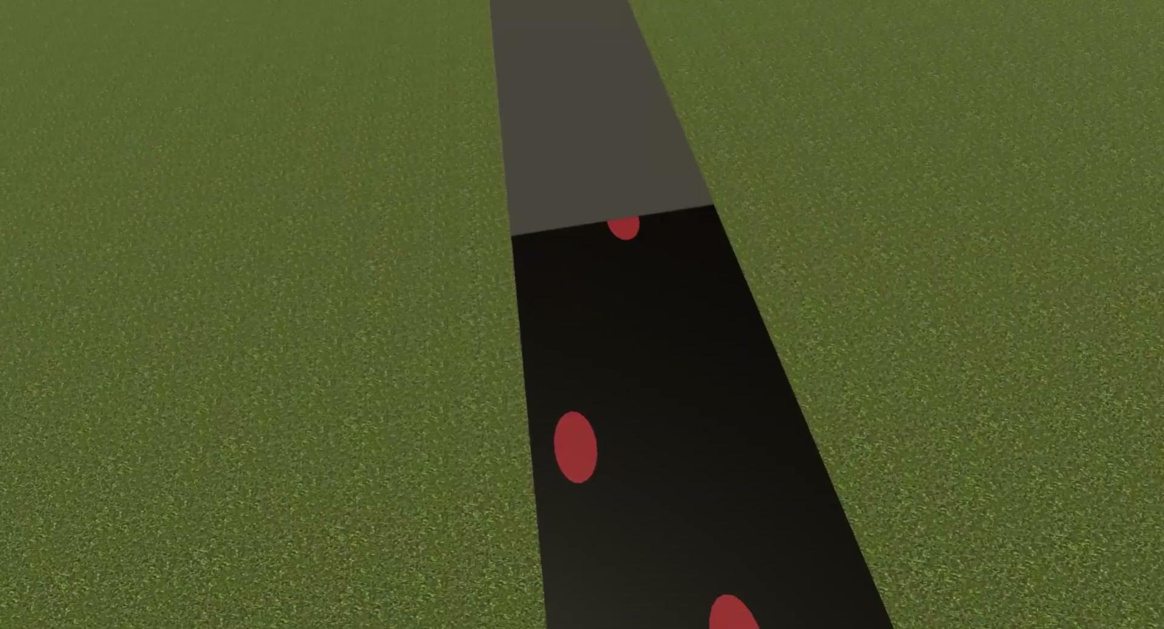
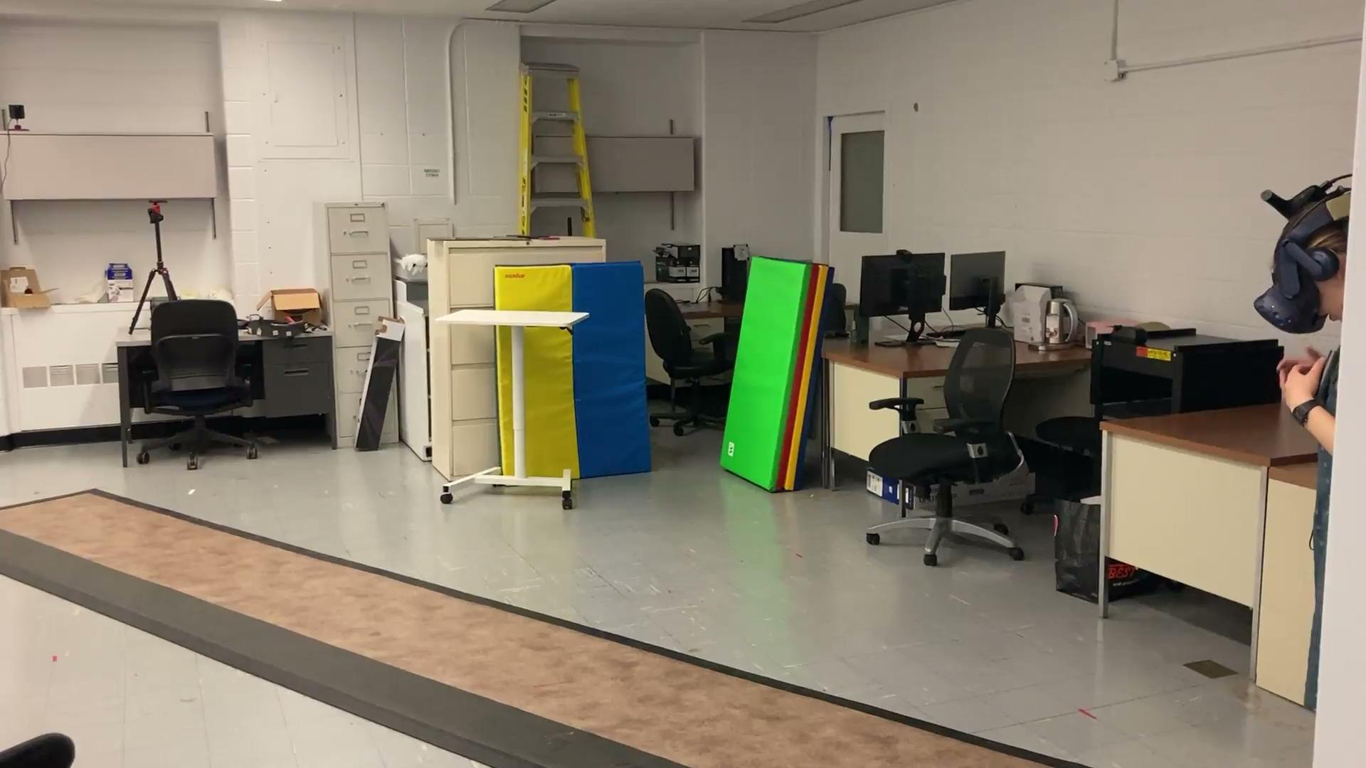
Methods
Developed virtual reality environment capable of providing auditory and/or visual cues for gait
Performed pilot study on six healthy individuals
Assessed musical background and beat perception
Measured gait parameters under seven conditions
Notes:
The first part was developing a virtual reality environment that could provide auditory and/or visual cues, which I did in Unity. The program that I built enables you to input participant’s baseline gait parameters, meaning how they normally, comfortably walk, and it adjusts the cues accordingly. So it changes how far apart the footsteps are for visual cueing and the tempo of the music for the auditory cue. The mat you can see in the image of the actual room on the right is an instrumented mat that measures different gait parameters as someone walks across it, and it’s mapped one-to-one in the virtual environment.
I’ll now show a side-by-side video of the view from the perspective of the person walking in VR, on the left, and of them walking in real life across the mat, on the right.
The next part of the project was to come up with and perform a pilot study using this virtual environment on healthy individuals. The study entailed having participants take a pre-survey, which assesses their musical background and beat perception. Then, I measured their gait parameters under seven different conditions, which were variations and combinations of visual and auditory cueing. As you can see in the flowchart, they first did a baseline walk, without any cueing. Then, they went through six cued conditions. For each condition, they walked 10 laps back and forth across the mat. Offset cueing means that the cue for one foot is longer than for the other, inducing asymmetric walking. After walking with each type of cueing individually, they went through two conditions of having both kinds of cueing simultaneously.

Slide 4
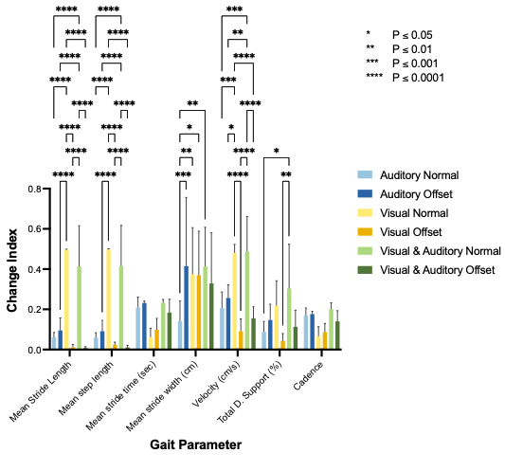
Results
Baseline
Auditory offset
Both auditory and visual cueing (normal)
Example of how gait changes under cueing conditions
Chart showing change indices and SD of each gait parameter by cueing condition
Notes:
The images on the left are a visual example of how one of the participants’ gait changed during the different cueing conditions. These images are taken from the PKMAS (ProtoKinetics Movement Analysis Software) software, which is used to process and analyze participants’ gait parameters. You can see how in the auditory offset, steps are slightly paired together in groups of two, and then with both auditory and visual cueing, the stride length is greatly reduced.
To analyze the data, I looked at the change index of each gait parameter for each person. The change index is the cued parameter value minus their baseline value for that parameter, all over their baseline value. I used changed indices because they’re an independent variable that enabled me to look at an absolute measure of how much each type of cue impacts a certain gait parameter.
The chart on the right shows the average change indices and standard deviation of each gait parameter by cueing condition. It shows how significantly a gait parameter was impacted by one type of cueing relative to another. For example, if you look at mean stride length, you can see that the visual normal condition (in yellow) caused a significant impact on stride length relative to auditory cueing (blue).

Slide 5
Discussion
Found that temporal gait parameters (stride time and cadence) can be impacted most effectively using auditory cueing, while spatial parameters (stride and step length) are changed most by visual cues
Results suggest that auditory and visual cueing cannot be used interchangeably, and using both types simultaneously may have further positive benefits
Greater sample size needed to determine connection between musical experience/beat perception ability and response to auditory cues
Further studies should investigate how people with Parkinson’s disease respond to a combination of both types of cueing
Notes:
From running the study on the six healthy individuals, I found that temporal gait parameters (stride time and cadence) were most changed by auditory cueing, while spatial parameters, like stride and step length), were most impacted by visual cues. This confirms that the cueing methods I developed were effective.
The results also suggest that auditory and visual cueing cannot be used interchangeably, and as some of the gait parameters were most changed under the condition of having both types of cues, using both auditory and visual cueing simultaneously in gait therapy may have even greater benefits than just using one.
In terms of determining if there’s a correlation between musical experience or beat perception ability and response to auditory cues, I found the Pearson’s correlation coefficient for cadence and stride time versus musical experience and beat perception. The r value that I found was statistically significant for the sample size of the study, which indicates that there is likely some sort of relationship between having higher musical experience and ability and responding better to auditory cueing, but because of the small sample size for the study, it’s not possible to make a complete conclusion about the connection.
This pilot study enabled me to test the VR cueing environment that I created and find preliminary results on a comparison between the effects of visual and auditory cueing. Further studies should investigate how people with Parkinson’s disease respond to a combination of both types of cueing so that these forms of gait therapy can be used in the most effective and efficient way possible.
Thank you for listening to my presentation, and I wanted to thank again Dr. Agrawal, Fitsum Petros, and the Columbia-Amazon SURE program for providing me with this opportunity to get a first-hand experience of going through the steps of a research project, from preliminary research, to developing a study, to running the study on people and interpreting the results.

