Slide 1
“Carbonation and grinding of recycled cement powder as an effective new method of carbon capture, utilization, and storage”
Bianca Byfield¹ , Diandian Zhao², Shiho Kawashima²
1. Harvard University, Cambridge, MA 02138, USA
2. Department of Civil Engineering and Engineering Mechanics, Columbia University, New York, NY 10027, USA

Slide 2
Introduction
The manufacturing of cement accounts for ~7% of global anthropogenic carbon dioxide (CO₂) emissions [1]
Current methods of Carbon Capture, Utilization, and Storage (CCUS) technology in the cement industry are based in an energy intensive process called calcium looping
A proposed new process involves taking recycled cement powder (RCP), carbonizing it, then using it as a Supplementary Cementitious Material (SCM) in order to be reused in construction
One limitation of carbonation is packing density and particle size of the carbonation products which limits the diffusion of the CO₂ and therefore reduces its ability to react and form more products. Finding ways to improve this carbonation degree will make this process more efficient
This study aims to investigate the carbonation of RCP as well as determine if grinding during the carbonation process improves the carbonation degree

Slide 3
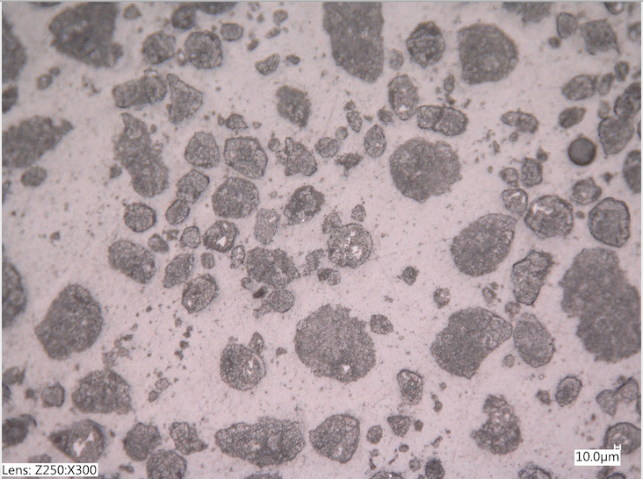
Methods
Two samples of 10g of RCP were carbonated in an incubator with a concentration of 20% CO₂
CO₂ uptake was determined by weighing periodically over the course of 18 days, with sample 1 being ground after the mass increase reached a plateau
Phase changes were found by performing Thermogravimetric/Differential Thermogravimetric analysis (TGA-DTG) after 0, 96, and 361 hours of carbonation
Figure 1: RCP sample under optical microscope (10$μm$)

Slide 4
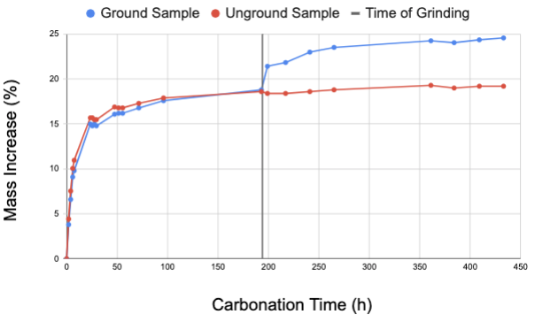
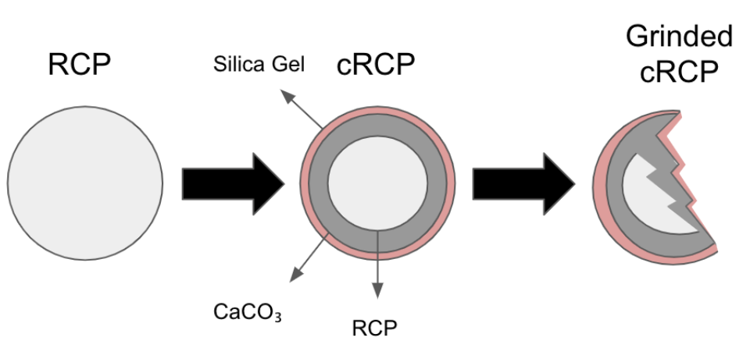
Results
Figure 2: Mass increase due to carbonation. After grinding sample 1 was able to uptake more CO₂
Figure 3: Schematic of grinding. Grinding exposes more surface area of the RCP and removes outer layer of carbonation products

Slide 5
The goal of this research was to observe the carbonation of RCP as well as to study the impact of grinding on the carbonation process
Conclusions
Future Work
Grinding results in the formation of more products and therefore is an effective way of improving the carbonation degree of RCP
The carbonation product of CaCO₃ is formed from the consumption of both Ca(OH)₂ and C-S-H
Use scanning electron microscope (SEM) to observe and compare carbonation products
Comparison of RCP vs carbonated RCP compressive strengths

